Slide 1



Cross Platform Development With Xamarin
Lori Lalonde
@loriblalonde

Slide 2






Me, Myself and I
CTTDNUG
Twitter: @loriblalonde
Email: loriblalonde@gmail.com
Blog: geekswithblogs.net/lorilalonde
LinkedIn: http://ca.linkedin.com/in/lorilalonde

Slide 3
What’s all the fuss about?

Slide 4
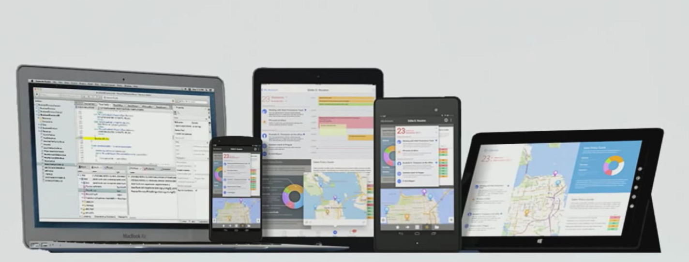
Develop for Multiple Platforms
Notes:
Xamarin has made it possible for .NET developers to create native cross platform mobile apps using C#, extending the .NET developer‘s reach to 2.6 billion devices around the world.

Slide 5
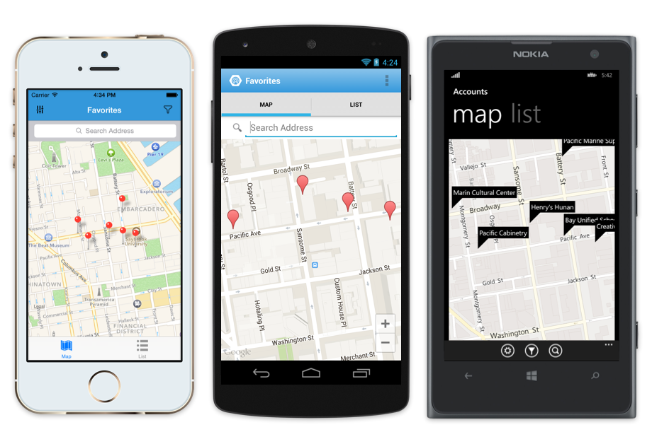
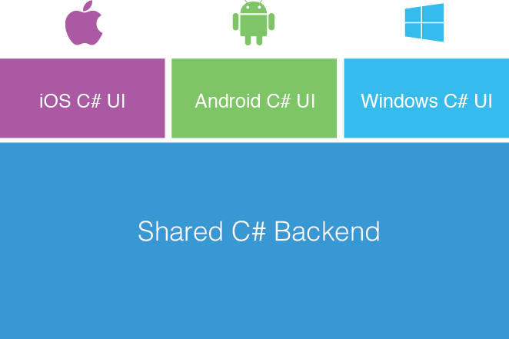
Xamarin’s Approach
Fully native apps written in C#
Shared App Logic in C#
Notes:
Xamarin delivers fully native user interfaces and app functionality
Complete access to 100% of the native APIs for iOS, Android and Windows in C#
Up to date with latest SDKs and OS releases
Share app logic and UI code across device platforms
iOS: Xamarin now supports HealthKit, PhotoKit, HomeKit, etc (September 2014) and WatchKit (January 20^{th,} 2015 preview released). Unified API with 64-bit support.
Android: Android Support v7 AppCompat, Android Wear UI, Android 5.0 (Lollipop)

Slide 6
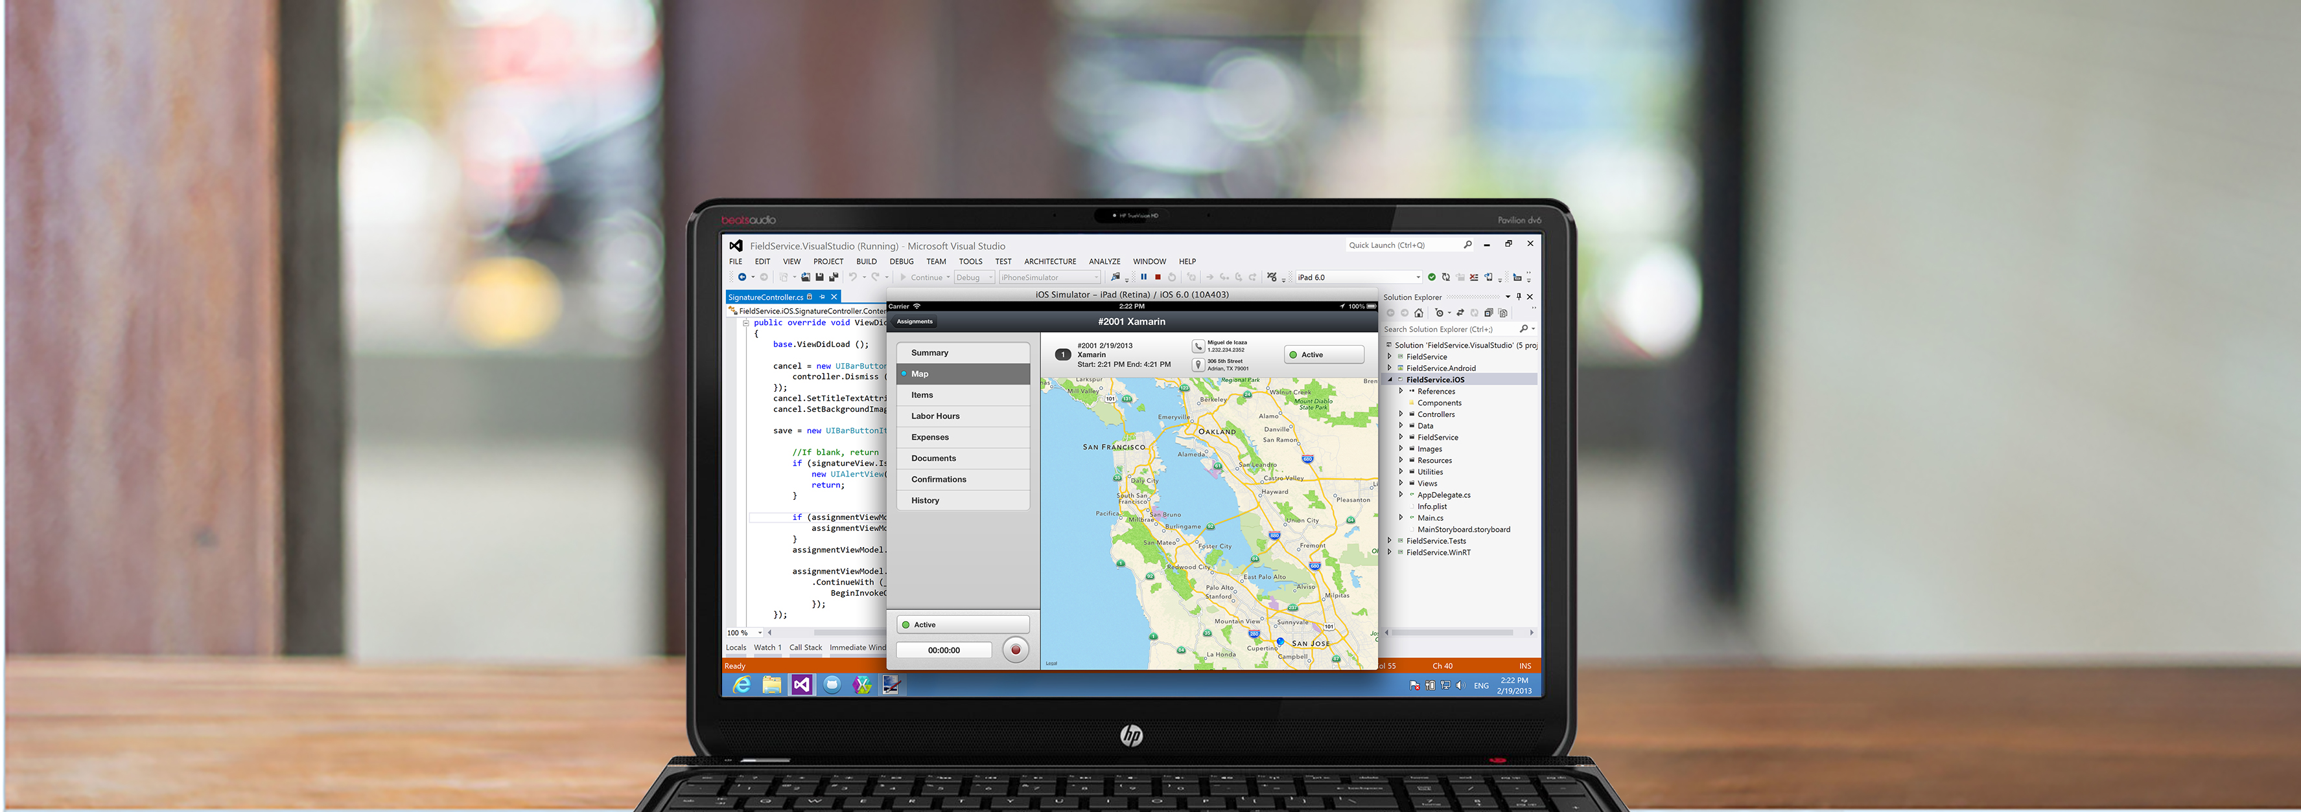

Anything you can do in Objective-C or Java can be done in C# with Xamarin.

Slide 7
What do I need to know (besides C#)?

Slide 8
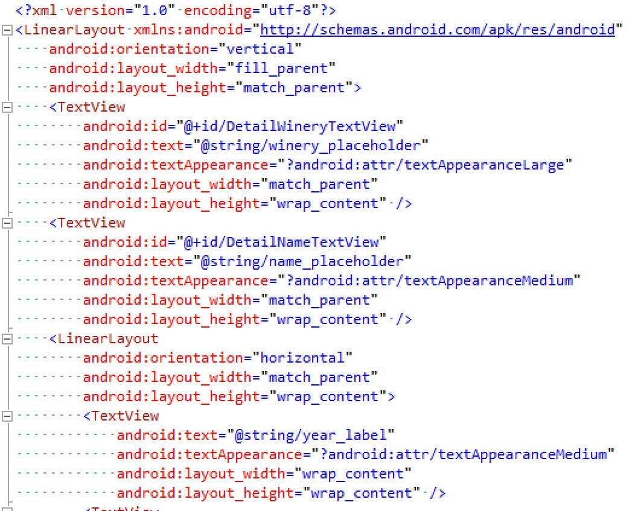
Xamarin.Android
Application lifecycle
Android layouts
Activities, Fragments
Resources
…and more
Shared App Logic in C#

Slide 9
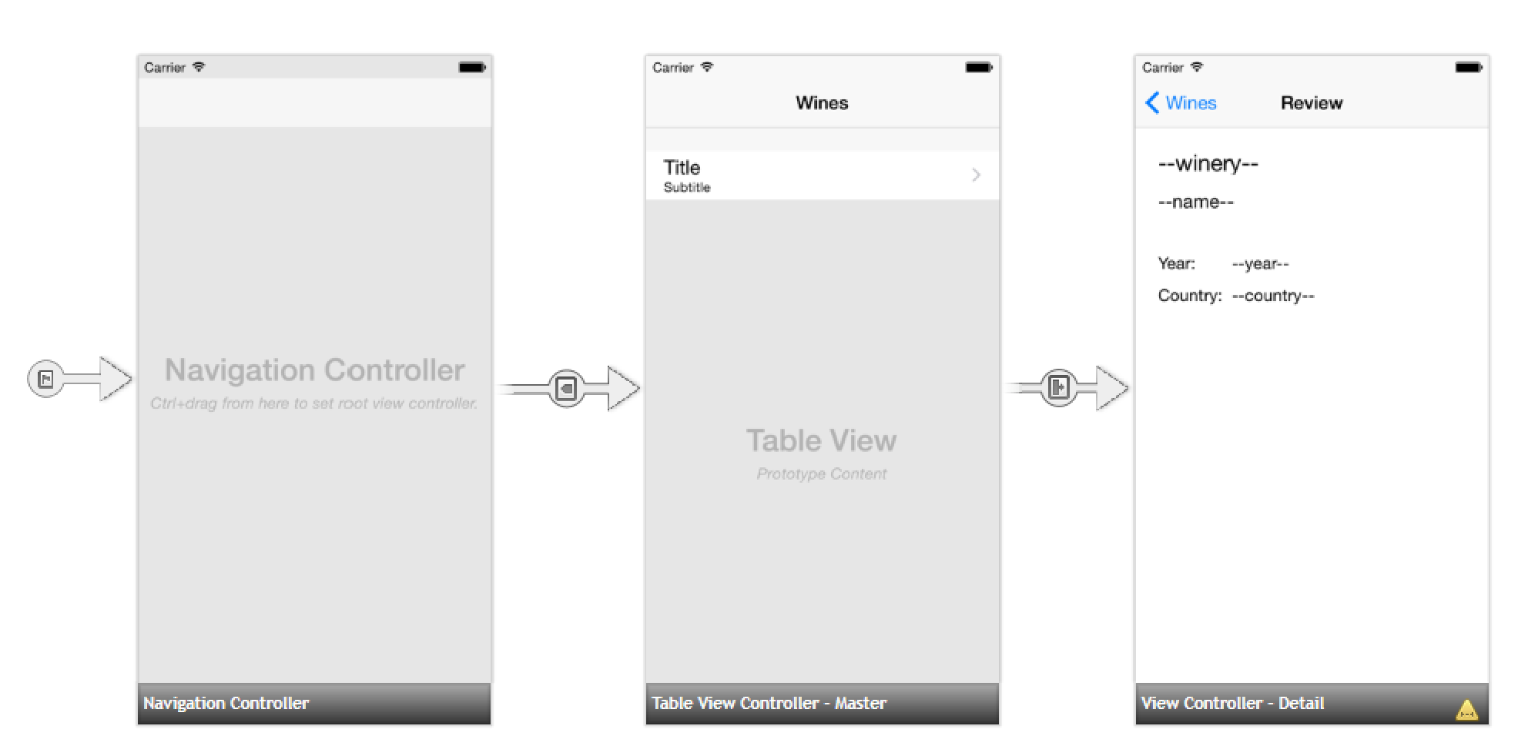
Xamarin.iOS
Application lifecycle
Storyboards
Segues
…and more

Slide 10


Do I REALLY Need A Mac?
Yes
+

Slide 11
How do I get started?

Slide 12
Xamarin Licenses
Starter
Indie
FREE
Limited app size
$25/month*
Unlimited app size
Business
Organization
$999/year*
Email support
Additional business features
$1899/year*
The world’s your oyster
* Per developer, per platform
Notes:
Starter edition available in Visual Studio Community Edition 2013 Update 4 and directly in Visual Studio 2015 CTP Update 6
Indie – only Xamarin Studio support
Business – supports in-house deployment, headless builds, System.Data.SqlClient
Enterprise – 1 business day SLA, Hotfixes, technical kick-off session, technical account manager, encrypted local data storage, code troubleshooting

Slide 13


The Tools
OR
Xamarin Studio
+ Xamarin Plug-Ins
Notes:
Xamarin Studio – supports Android, iOS
Limitations – Xamarin.iOS only available on Mac, Windows Phone not supported
Mac Requirements – OS 10.8 (“Mountain Lion”) or higher, Xcode/iOS SDK, Xamarin Platform
Windows Requirements – Windows 7 or higher, Xamarin Platform, Connected to Mac (Xamarin.iOS dev only)

Slide 14
Visual Studio / Xamarin Plug-in
Requirements
Windows 8 64 bit Visual Studio 2012 Professional with Update 4 or higher
Xamarin License(s) - Android and/or iOS
Xamarin Platform
Connected to Mac (iOS dev only)
Xamarin Starter edition available in Visual Studio Community 2013 with Update 4 (non-enterprise app dev)
Shared App Logic in C#
Notes:
Xamarin VS plug-in - Supports Xamarin.Android, Xamarin.iOS, Windows Phone 8 Silverlight (for Xamarin.Forms development)
Limitations – Xamarin.iOS only available when connected to a Mac

Slide 15
Demo

Slide 16
Code Sharing Strategies

Slide 17

Xamarin’s Default App Architecture
iOS C# UI
Android C# UI
Windows C# UI
Shared App Logic
~75% - 90% code reuse
Shared App Logic in C#
Notes:
Good for apps with sophisticated UX requirements (complicated gestures, animations, design)

Slide 18

Xamarin.Forms App Architecture
Xamarin.Forms
Shared App Logic
~90 - 99% code reuse
Notes:
Good for forms based apps with many data entry screens
Xamarin just added support for application lifetime

Slide 19
Code Sharing Strategies
Shared Library
File linking
Compiled with each platform-specific project
Portable Class Library
Separate library, compiled independently
Added as a reference to each platform-specific project
Shared App Logic in C#

Slide 20
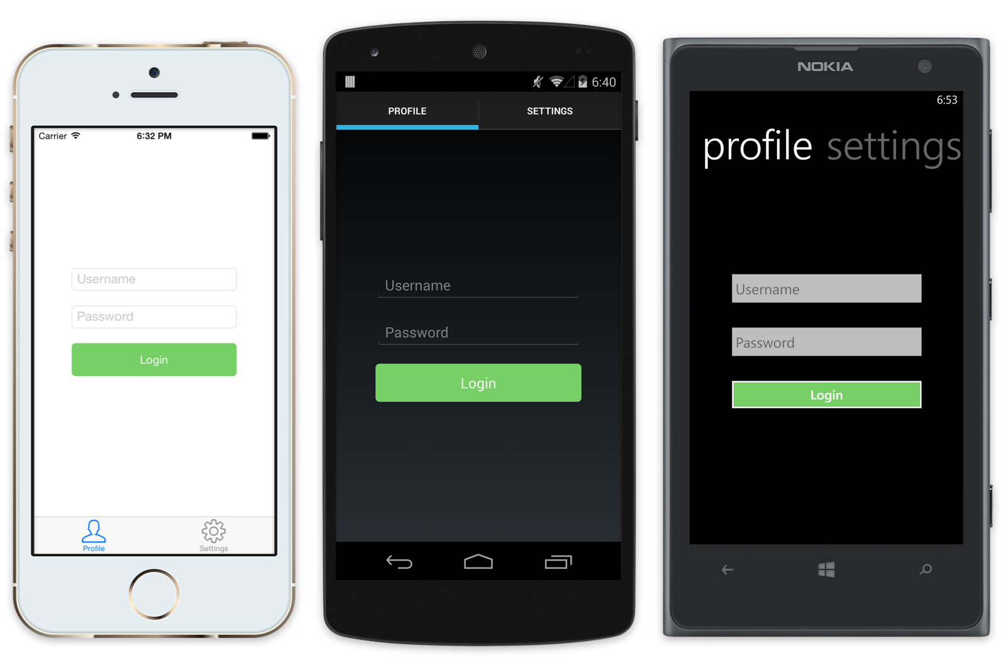
Xamarin.Forms: Build Native User Interfaces using Shared Code
Notes:
At runtime, each Xamarin.Forms page and its controls are mapped to platform-specific native user interface elements
Use a single API to generate native, platform-specific user interfaces

Slide 21



Data Storage Options

Slide 22
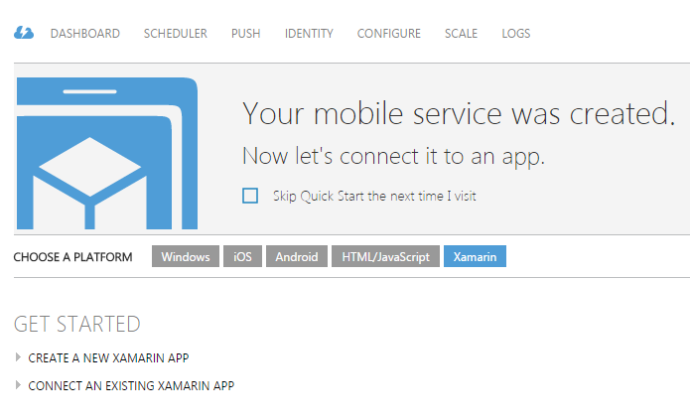
Xamarin and Windows Azure Mobile Services
Provide cloud-based backend service for your Xamarin apps
Include authentication using Microsoft Account, Facebook, Twitter, Google or Azure Active Directory
Send push notifications

Slide 23


Slide 24
Demo

Slide 25
Xamarin Certification

Slide 26
Xamarin Mobile Developer Certification
Subscribe to Xamarin University
Complete the required courses
Pass the exam (80% or higher)
Certification is valid for 1 year

Slide 27
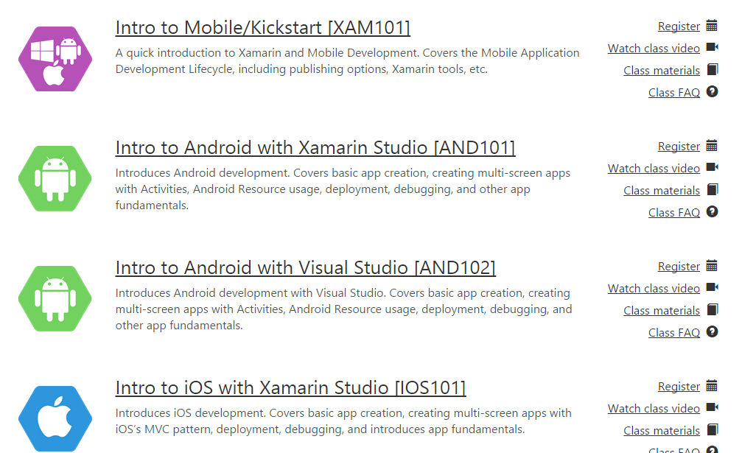
Xamarin University
university.xamarin.com
$1995 US / year
Over 50 classes
Live instructor-led classes
Access to pre-recorded videos and labs

Slide 28
Additional Resources
Xamarin Documentation – developer.xamarin.com
Pluralsight – pluralsight.com
Book: Xamarin Cross Platform Application Development by Jonathan Peppers (available on Amazon)

Slide 29
Questions?

Slide 30

Please fill out the session survey…
Your feedback matters!

Slide 31
Thanks!
Twitter: @loriblalonde
Email: loriblalonde@gmail.com
Blog: geekswithblogs.net/lorilalonde
LinkedIn: http://ca.linkedin.com/in/lorilalonde

